Slide 1
Modal Decomposition Analysis of Controlled, Internal Flow Separation
Hemanth Sarabu, Curtis J. Peterson, Bojan Vukasinovic, and Ari Glezer
Woodruff School of Mechanical Engineering
Georgia Institute of Technology

Slide 2
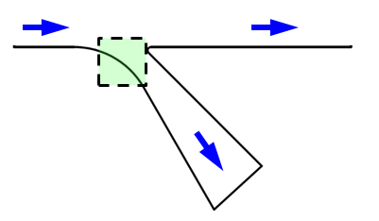
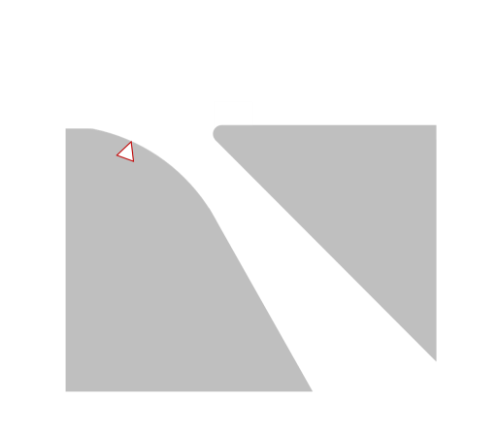
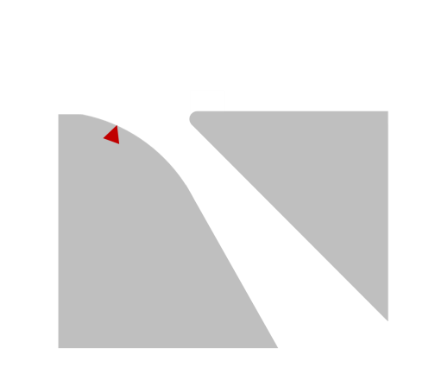
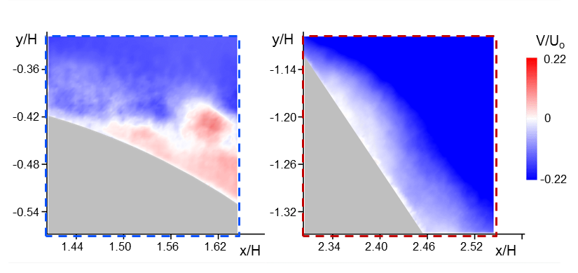
Dynamics of Controlled, Separating Flow
The flow in compact diffuser ducts is susceptible to local separation
Separation dynamics are clearly altered in the presence of flow control
Present investigation focuses on the change in flow structure and changes in characteristics between separation in the unforced flow and in the presence of actuation
Small scale features and turbulent flow characteristics
Scaling
Flow Separation
y/H
Base
y/H
Controlled
0.0
0.0
8
-1.0
-1.0
ζ∙H/U_{o}
-2.0
-2.0
-3.0
-3.0
-8
1.0
2.0
3.0
4.0
x/H
1.0
2.0
3.0
4.0
x/H
Notes:
Flow in compact diffusers is susceptible to separation
We are interested in the dynamics of the flow near separation and their changes under flow control
Investigated in a diverging diffuser that imposes an adverse pressure gradient
Separation is controlled with an integrated array of fluidic oscillating jets
As separation migrates downstream the action of flow @ interface of separation changes, and we want to examine the differences in dynamics and structure as separation moves
To highlight this, 2 cases examined
Ensemble averaged fields, colored by vorticity, for unactuated (left) and actuated (right) show separation moving downstream
Movies show instantaneous dynamics centered at separation determined in large fields for both base and controlled
Colored by vertical velocity
Show large difference in dynamics and structure @ separation interface as sep moves downstream
Will be explored using variety of turbulent parameters and scaling

Slide 3
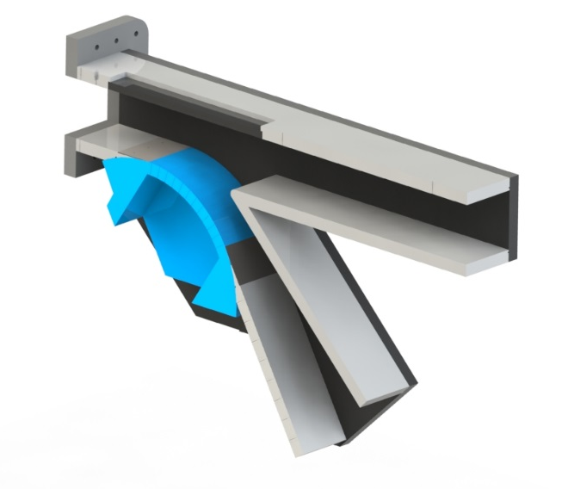
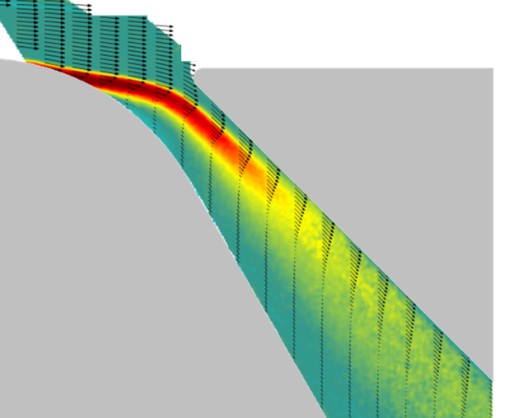
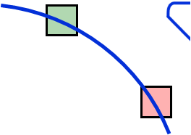
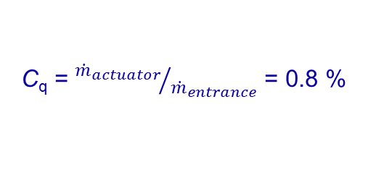
Experimental Setup
641.4 mm
Laser
Sheet
M_{o} ,U_{o}
Pitot Probe
76.2 mm
y, V
Pitot
Probe
x, U
45°
R 152.4 mm
Flow
Control
Mach Mapping
Static
Wall
Pressure
15°
Zoomed In Windows
Fluidic Oscillators
C_{q} = ${{\dot{m}}_{actuator}}/{{\dot{m}}_{entrance}}$ = 0.8 %
C_{q} = 0
0.1 < M < 0.4
f_{act} = O [10 kHz]
St_{act} =O [10⁴ ]
C_{q} = 0.8%
Notes:
Flow in diffuser characterized by sets of partially overlapping PIV fields with smaller (more resolved) windows centered @ separation determined from large fields (Shown below)
Inlet Mach # determined from upstream pitot probe and set to nominal M= 0.4 for the following
Setup incorporates a flow control module integrated into the inlet section of diffuser. This module is composed of an array of fluidic oscillating jets that turn continuous air supply into oscillating jets
The flow control parameter Cq defined as ratio of mass flow through jets and through the test section

Slide 4


Turbulent Kinetic Energy at Separation
Ensemble Average Vorticity
Separation Histogram
Ensemble Average TKE
Binned Field
y/H
y/H
-0.4
-0.42
-1
-0.42
q×10³
-0.6
TKE
-0.48
8
-0.48
27
-0.8
-0.54
C_{q} = 0
0
.5
x/S
1
-0.54
1.44
1.50
1.56
1.62
-2
1.4
1.6
1.8
2.0
1.44
1.50
1.56
1.62
ζ∙H/U_{o}
y/H
y/H
-8
-1.14
-1.14
0
-1.20
-1
-1.20
-1.2
-1.26
-1.26
-1.3
-1.32
-1.32
C_{q} = 0.8%
2.3
2.4
2.34
2.40
2.46
0
.5
x/H
1
2.34
2.40
2.46
x/H
-2
x/S
x/H
2
x/H
3
Notes:
2 larger fields of view show the ensemble avg vorticity distribution for M=0.4 base flow and actuated flow at Cq = 0.8, Their corresponding TKE distribution are shown ion right
However, as has been shown, the separation dynamics are varied locally, so the smaller fields of view are shown right( higher resolution PIV windows focused about separation determined from the larger views are considered)
The locally resolved TKE levels are shown for base and controlled flow
This highlights the increase in TKE levels about separation and the shift towards surface
However, the averaging smooths out some of the features of the dynamics, so can use the separation histograms to examine conditionally averaged flow fields based on separation location
Bin shown in red and local TKE field right
Shows the increase in TKE past separation, and that in controlled cases TKE is higher in entire field compared to base flow

Slide 5
Spectral Analysis
y/H
y/H
5 mm
-0.36
-1.14
-0.42
PIV measurements with about 250 μm spatial resolution and 2.5 kHz bandwidth
-1.20
5 mm
-0.48
-1.26
-0.54
-1.32
1.44
1.50
1.56
1.62
x/H
2.34
2.40
2.46
2.52
x/H
0
q/U_{o}²
27
Velocity Fluctuations Spectra
-5/3
psd
C_{q}
▬ 0
▬ 0.8%
Increased large-scale energy in a narrower band
Less energy in the small scales
f [Hz]
Notes:
Knowing TKE increases further near separation as it migrates downstream with actuation, want to gain insight into the local scales and spectral content @ separation, AVG TKE shown again for reference
To do this, more resolved PIV windows shown in red are used. The ensuing PIV field is shown in comparison to a hotwire probe.
Data is then taken at 5 kHz giving both time and spatially resolved data in comparison to a single probe
Spectra assocauted with natural separation in black, actuated in red
Shows significant change in spectral content near separation in actuated case, contributing to the rise in TKE
Note the increased power of lower frequencies in actuated case, which indicated large scale oscillations near separation
There is also an earlier decay to small scales that is not seen in the (upstream) base flow
Early decay is attributed to the forcing / actuation such that the dissipation to small scales is happening @ lower frequencies, and thereby reducing energy contained in these smaller scales

Slide 6
Empirical Mode Decomposition
EMD Sifting Process
Original Signal
Envelope Definition
Intrinsic Mode Function
(IMF)
Repeat Process on Residuals
Breaks down original signal into varying frequency bands
Bands start from high and move to low frequencies
Application to both nonlinear and non-stationary processes due to time domain basis
Fewer resultant “modes” of the flow compared to other decompositions

Slide 7
Intrinsic Mode Functions
IMF 1
IMF 1
IMF 2
IMF 2
IMF5
IMF 5
Amplitude
(m/s)
IMF6
IMF 6
IMF 10
IMF 10
Time Instance
Time Instance

Slide 8
IMF Spectra
Unactuated Flow
Actuated Flow
P
P
F
F
Increased power spectral density for corresponding IMFs
= Raw Signal
= IMF 3
= IMF 1
= IMF 4
= IMF 2
= IMF 5

Slide 9
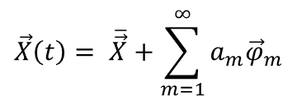
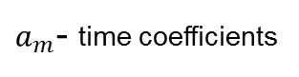
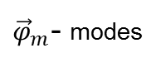
Local Flow Structure at Separation
Modal Energy
POD
20
C_{q} = 0
0.8%
$$\vec{X}\left(t\right)= \overline{\vec{X}}+\sum_{m=1}^{∞}{a_{m}{\vec{φ}}_{m}}$$
${\vec{φ}}_{m}$- modes
15
E [%]
$a_{m}$- time coefficients
10
5
0
1
m
20
1
m
20
Vorticity Modes
m = 1
2
3
4
5
6
-0.41
C_{q} = 0
y/H
-0.47
-0.41
C_{q} = 0.8%
y/H
-0.47
1.50
x/H
1.56
Flow structure at separation similar; only tilted and stretched
Notes:
Using the same small view of separation used for spectral analysis, the local structure of the flow can be examined using the POD
1st six modes of vorticity are shown for the base and actuated flows
The modes show that although there was a large spectral difference and the actuated flow indicated increased energy in large scale motions, the local underlying flow structure is fundamentally similar between the cases although the modes are slightly tilted and stretched along the surface.
And while the structure is similar, the energy fraction of the 1st two modes increases under actuation, which is in line with the increased energy content of the large scales uncovered by the spectral content of the flows near separation

Slide 10
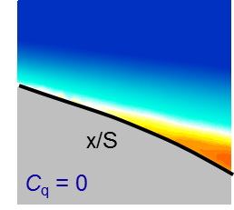
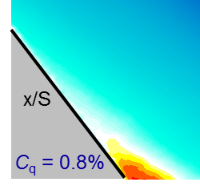
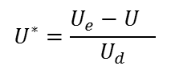
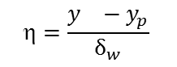
Scaling of Velocity Profiles
C_{q}
Base
Controlled
30.0
○ 0
• 0.8%
y_{n}
$$=\frac{y_{}−y_{p}}{δ_{w}}$$
15.0
$$U^{∗}=\frac{U_{e}−U_{}}{U_{d}}$$
0.0
-0.2
-0.1
0.0
0.1
0.2
x/s
Outer Scaling
(Schatzman & Thomas, 2017)
Inner/Outer Scaling
6.0
6.0
η
η
4.0
4.0
2.0
2.0
0.0
0.0
-2.0
-2.0
-4.0
-4.0
-6.0
0.0
1.0
2.0
3.0
4.0
-6.0
0.0
1.0
2.0
3.0
4.0
U*
U*
Notes:
As the underlying flow features appear to be structurally similar, want to look at being able to scale the flows
the evolution of the flow through separation is further examined in the average sense for the base and controlled flows (shown left for reference )
Velocity profiles are extracted, RED vs BLACK, secondary inflection shows up in average for actuated
Avg velocity profiles with Separation centered in middle, with natural separation in black , actuated in red with supplemental equidistant velocity profiles up and downstream are shown
Although near wall features of the separating profiles are similar, the full velocity profiles are vastly different, with the controlled flow scale being nearly 3 fold of the base flow
In such flows where the dominant shear is away from the wall, Schatzman and Thomas postulated that the flow is dominated by shear induced dynamics rather than near wall features
Instead of traditional velocity scaling based on wall coordinates, THEY proposed scaling related to the outer embedded shear layer displaced from the surface, which is related to the profile inflection point shown schematically here
When using this scaling, there is an excellent collapse of all the profiles except a trail off near the wall in larger negative ETA
However, the actuated flow develops a secondary inflection point as separation is delayed into the diffuser into significant APG
Shown on right, that even better collapse can be achieved if the inner region is scaled by the inner inflection and the outer region scaling is preserved
This duality in the scaling can be arguably related to the outer shear and vorticity brought closer to the wall by actuation in the downstream view.
So has been shown that although actuation significantly increases the global TKE about separation which has a large effect on the spectral content, fundamentally, the flow near separation in both actuation cases is actually similar.
Where does this lead us…..

Slide 11
Conclusions
The flow structure and dynamics near the onset of separation in a diffuser flow is investigated in the absence and presence of separation control
Separation delay is accompanied by significant increase in the characteristic cross-stream scale
The turbulent kinetic energy at separation increases significantly in the presence of actuation
EMD shows increased energy in the spectral band of successive IMFs with actuation
POD modes exhibit similar underlying structure at separation in the absence and presence of actuation, despite significant changes in cross stream scales
Because the flow at separation is driven by the embedded cross flow shear, the mean velocity field is shown to scale accordingly, despite major changes in cross stream scales and spectral content

